Slide 1
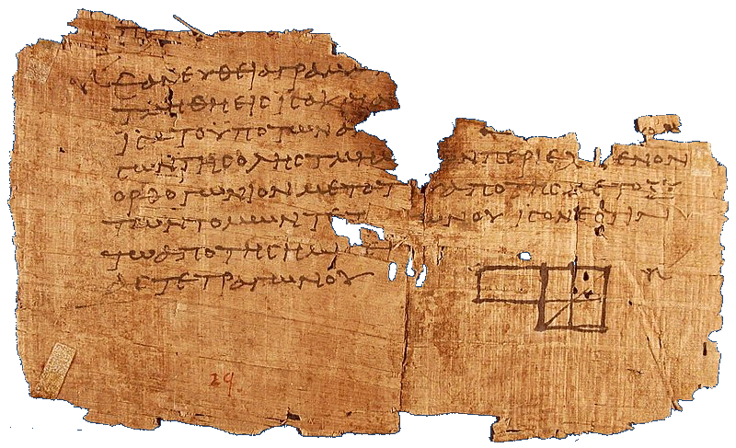




Euclidean geometry and trigonometry
Euclidean geometry means flat space
sine and cosine
y
θ
x
Calculating $π$
Trigonometric identities
$$β$$
ACME
$$2π$$
1
$$α$$

Slide 2
Euclidean geometry
(1) Line segment
A
B
(2) Extend line segment into line
D
C
F
E
(5) Parallel postulate
(3) Use line segment to define circle
(4) All right angles are equal

Slide 3
Euclidean geometry: Flat space
Non-embeddable spaces
(Cannot be drawn as rippled surfaces in higher-dimensional flat spaces)
Flat
Curved
(5) Parallel postulate

Slide 4
Euclidean geometry: Pythagorean theorem
c
b
a

Slide 5
Euclidean geometry: Pythagorean theorem
Want to show
a² + b² = c²
c²
c
b
b²
a
a²

Slide 6


Euclidean geometry: Pythagorean theorem
Want to show
c
a² + b² = c²
b
ab/2
(a - b)² + 4ab/2 = c²
a² -2ab + b² + 2ab = c²
a
ab/2
a² + b² = c²
b
a - b
(a – b)²
ab/2
$$c=\sqrt{a^{2}+b^{2}}$$
ab/2

Slide 7
Euclidean geometry and trigonometry
Euclidean geometry means flat space
sine and cosine
y
θ
x
Calculating $π$
Trigonometric identities
$$β$$
ACME
$$2π$$
1
$$α$$

Slide 8
Trigonometry: sine and cosine
y
1
θ
θ
x

Slide 9

Trigonometry: sine and cosine
y
1
y = sin(θ)
θ
ACME
x
x = cos(θ)
$$2π$$

Slide 10

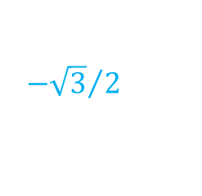





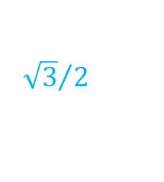





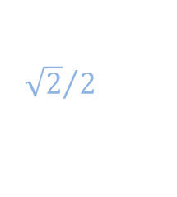







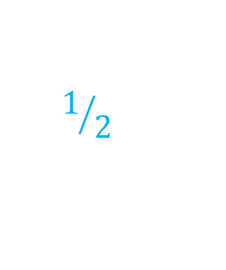



Trigonometry: sine and cosine
y
1
$$\sin\left(θ\right)$$
$${\sqrt{3}}/2$$
$${\sqrt{2}}/2$$
x
$$1/2$$
$$\cos\left(θ\right)$$
$$θ$$
0
$$\frac{2π}{3}$$
$$\frac{3π}{4}$$
$$\frac{5π}{6}$$
$$\frac{5π}{4}$$
$$\frac{3π}{2}$$
$$\frac{5π}{3}$$
$$\frac{11π}{6}$$
$$\frac{π}{6}$$
$$\frac{π}{4}$$
$$\frac{π}{3}$$
$$\frac{π}{2}$$
$$π$$
$$\frac{7π}{6}$$
$$\frac{4π}{3}$$
$$\frac{7π}{4}$$
$$2π$$
$$−1/2$$
$${−\sqrt{2}}/2$$
$${−\sqrt{3}}/2$$
-1

Slide 11
Trigonometry: sine and cosine
1
$$\sin\left(θ\right)$$
$${\sqrt{3}}/2$$
$${\sqrt{2}}/2$$
$$1/2$$
$$\cos\left(θ\right)$$
$$θ$$
0
$$\frac{2π}{3}$$
$$\frac{3π}{4}$$
$$\frac{5π}{6}$$
$$\frac{5π}{4}$$
$$\frac{3π}{2}$$
$$\frac{5π}{3}$$
$$\frac{11π}{6}$$
$$\frac{π}{6}$$
$$\frac{π}{4}$$
$$\frac{π}{3}$$
$$\frac{π}{2}$$
$$π$$
$$\frac{7π}{6}$$
$$\frac{4π}{3}$$
$$\frac{7π}{4}$$
$$2π$$
$$−1/2$$
$${−\sqrt{2}}/2$$
$${−\sqrt{3}}/2$$
-1

Slide 12
Euclidean geometry and trigonometry
Euclidean geometry means flat space
sine and cosine
y
θ
x
Calculating $π$
Trigonometric identities
$$β$$
ACME
$$2π$$
1
$$α$$

Slide 13












Trigonometry: $π$
1
Want to approximate $π$
$$\frac{π}{3}$$
$$\frac{π}{3}$$
$$\frac{π}{3}$$
$$\frac{π}{3}$$
1
1
1
1
$$\frac{π}{3}$$
$$\frac{π}{3}$$
$$\frac{π}{3}$$
$$\frac{π}{3}$$
$$\frac{π}{3}$$
ACME
1
1
$$2π$$
1

Slide 14
Trigonometry: $π$
Want to approximate $π$
$$\frac{π}{3}$$
1
1
$$\frac{π}{3}$$
$$\frac{π}{3}$$
1

Slide 15









Trigonometry: $π$
Want to approximate $π$
$${\left(\frac{1}{2}\right)}^{2}+x^{2}=1^{2}$$
$$\frac{π}{3}$$
$$\frac{π}{6}$$
$$\frac{π}{6}$$
$$x^{2}=1−\frac{1}{4}$$
$$x=\sqrt{\frac{3}{4}}=\frac{\sqrt{3}}{2}$$
1
$$\frac{\sqrt{3}}{2}$$
1
x
$$\frac{π}{3}$$
$$\frac{π}{3}$$
1/2
1
1/2

Slide 16


Trigonometry: $π$
Want to approximate $π$
$${\left(\frac{1}{2}\right)}^{2}+x^{2}=1^{2}$$
$$\frac{π}{6}$$
$$\frac{π}{6}$$
$$x^{2}=1−\frac{1}{4}$$
$$x=\sqrt{\frac{3}{4}}=\frac{\sqrt{3}}{2}$$
1
$$\frac{\sqrt{3}}{2}$$
1
x
1
1/2
$$\frac{π}{3}$$
$$\frac{π}{6}$$
$$\frac{π}{3}$$
1/2
$$\frac{\sqrt{3}}{2}$$
1/2

Slide 17
Trigonometry: $π$
Want to approximate $π$
$${\left(\frac{1}{2}\right)}^{2}+x^{2}=1^{2}$$
$$x^{2}=1−\frac{1}{4}$$
$$x=\sqrt{\frac{3}{4}}=\frac{\sqrt{3}}{2}$$
1
1/2
$$\frac{π}{6}$$
$$\frac{\sqrt{3}}{2}$$

Slide 18









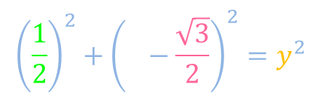

Trigonometry: $π$
$$\frac{π}{6}$$
Want to approximate $π$
$${\left(\frac{1}{2}\right)}^{2}+{\left(1−\frac{\sqrt{3}}{2}\right)}^{2}=y^{2}$$
$$\frac{1}{4}+{\left(\frac{2−\sqrt{3}}{2}\right)}^{2}=y^{2}$$
1
y
1/2
STOP
$$2−\sqrt{3}=y^{2}$$
$$y=\sqrt{2−\sqrt{3}}$$
$$\frac{π}{6}$$
$$\frac{π}{6}≳\sqrt{2−\sqrt{3}}$$
$$\frac{\sqrt{3}}{2}$$
$$1−\frac{\sqrt{3}}{2}$$
$$π≳6\sqrt{2−\sqrt{3}}$$
1
$$π≳3.1058$$

Slide 19

Trigonometry: $π$
Sine!
Sine!
Co
sine,
Sine!
ACME
3
.
1
4
1
5
9!
$$2π$$
1
$$π≳3.1058$$

Slide 20

Trigonometry: sine and cosine
1
$$\sin\left(θ\right)$$
$${\sqrt{3}}/2$$
$$1°≔\frac{π}{180}$$
$${\sqrt{2}}/2$$
$$1/2$$
$$\cos\left(θ\right)$$
$$θ$$
0
$$\frac{2π}{3}$$
$$\frac{3π}{4}$$
$$\frac{5π}{6}$$
$$\frac{5π}{4}$$
$$\frac{3π}{2}$$
$$\frac{5π}{3}$$
$$\frac{11π}{6}$$
$$\frac{π}{6}$$
$$\frac{π}{4}$$
$$\frac{π}{3}$$
$$\frac{π}{2}$$
$$π$$
$$\frac{7π}{6}$$
$$\frac{4π}{3}$$
$$\frac{7π}{4}$$
$$2π$$
0.524
0.785
1.047
1.571
2.094
2.356
2.618
3.142
3.665
$$−1/2$$
3.927
4.189
4.712
5.236
5.498
5.760
6.283
$${−\sqrt{2}}/2$$
30°
45°
60°
90°
120°
135°
150°
180°
210°
225°
240°
270°
300°
315°
330°
360°
$${−\sqrt{3}}/2$$
-1

Slide 21
Euclidean geometry and trigonometry
Euclidean geometry means flat space
sine and cosine
y
θ
x
Calculating $π$
Trigonometric identities
$$β$$
ACME
$$2π$$
1
$$α$$

Slide 22
Trigonometry: sine and cosine in terms of right triangles
y
1
y = sin(θ)
θ
x
x = cos(θ)

Slide 23
Trigonometry: sine and cosine in terms of right triangles
r
r sin(θ)
θ
r cos(θ)
1
sin(θ)
θ
R
cos(θ)
R sin(θ)
θ
R cos(θ)

Slide 24


Proving identities: Pythagorean identity
STOP
$$\cos^{2}\left(θ\right)+\sin^{2}\left(θ\right)= ?$$
$$\cos^{2}\left(θ\right)+\sin^{2}\left(θ\right)=1$$
Pythagorean identity
1
sin(θ)
θ
cos(θ)

Slide 25

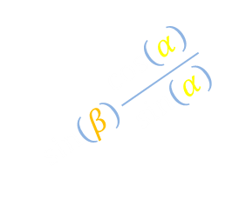








Proving identities: Angle addition formula
Want to show
$$\sin\left(α+β\right)=\sin\left(α\right)\cos\left(β\right)+\cos\left(α\right)\sin\left(β\right)$$
$$β$$
$$\frac{\sin\left(β\right)}{x}=\frac{h\sin\left(α\right)}{h\cos\left(α\right)}$$
$$\cos\left(β\right)$$
$$\sin\left(α+β\right)$$
1
$$\sin\left(β\right)\frac{\cos\left(α\right)}{\sin\left(α\right)}$$
x
$$\sin\left(β\right)$$
$$\frac{π}{2}−β$$
$$α$$
$$\frac{π}{2}−α$$
$$α+β$$
h

Slide 26
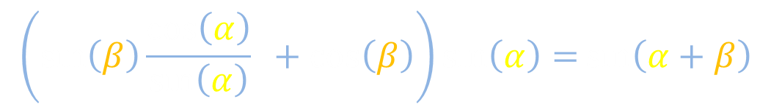
Proving identities: Angle addition formula
Want to show
$$\sin\left(α+β\right)=\sin\left(α\right)\cos\left(β\right)+\cos\left(α\right)\sin\left(β\right)$$
$$\left(\sin\left(β\right)\frac{\cos\left(α\right)}{\sin\left(α\right)} +\cos\left(β\right)\right)\sin\left(α\right)=\sin\left(α+β\right)$$
$$β$$
$$\cos\left(β\right)$$
$$\sin\left(α+β\right)$$
$$\sin\left(β\right)\frac{\cos\left(α\right)}{\sin\left(α\right)}$$
$$α$$

Slide 27
Trigonometry: $π$
Want to approximate $π$
$${\left(\frac{1}{2}\right)}^{2}+x^{2}=1^{2}$$
$$\frac{π}{6}$$
$$\frac{π}{6}$$
$$x^{2}=1−\frac{1}{4}$$
$$x=\sqrt{\frac{3}{4}}=\frac{\sqrt{3}}{2}$$
Hypotenuse
1
$$\frac{\sqrt{3}}{2}$$
1
Leg
x
$$\frac{π}{3}$$
$$\frac{π}{3}$$
Leg
1/2
1/2

